Slide 1
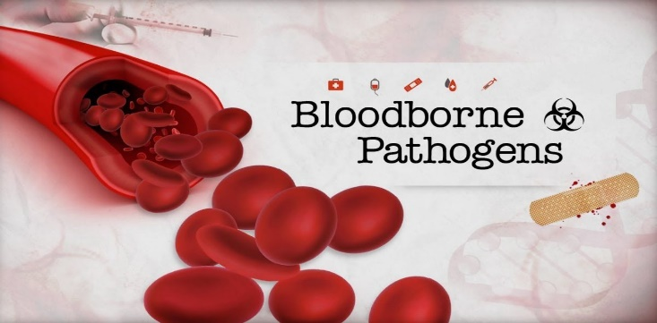
Bloodborne Pathogens and workPlace safety
By: Elizabeth Cummings RN, BSN, MSN-ED.
Updated Summer 2018

Slide 2
OSHA
Occupational Safety and Health Administration (OSHA)
Part of the Department of Labor
Two main standards
Occupational exposure to Hazardous Chemicals Standard
Blood Borne Pathogen Standard

Slide 3
OSHA Standards
Occupational Safety and Health Act of 1970
Passed to keep workers safe and free from harm
Workplace safety
Health standards
Has been amended several times

Slide 4
Bloodborne Pathogens
Approximately 5.6 million health care workers are at risk of exposure to bloodborne pathogens such as HIV, HBV, and HCV
Osha’s bloodborne pathogens standards requires safeguards to protect workers against the health hazards

Slide 5
Standards include
All employees who could be “reasonably anticipated” as the result of performing their job duties to face contact with blood and other potentially infectious materials
“good Samaritan”acts are not covered

Slide 6
Some people at risk are:
Physicians, nurses, ER personnel
Orderlies (Nurse aides), housekeeping, laundry workers
Dentists and dental workers
Laboratory and technologists and technicians
Medical examiners
Morticians
Law enforcement personnel
Firefighters
Paramedics, EMS, and Emts
Medical waste treatment employees
Home health workers
Certified medical assistants

Slide 7
Responsibilities of Employers
Must follow all OSHA safety and health standards
Must correct any breech of standards
Must provide on-going training about OSHA and health standards
Notify OSHA if major event occurs
Provide PPE free to employees
Keep record of all work related injuries
Post OSHA citations
Do not retaliate or discriminate toward workers exercising their rights

Slide 8
Must Train employees on universal precautions
Treat all human blood and certain body fluids as if they are infectious
Observed in all situations where there is a potential for contact with blood or other potentially infectious materials

Slide 9
Employee Rights
Safe working environment
Information and training
Review work related material/records/test results/surveys
File complaints with OSHA
Not be discriminated or retaliated against for exercising rights

Slide 10
Question #1
Employees have the right to work in what type of environment
A. An environment where education is offered only at the time of hiring
B. An environment that is adapted around his/her needs
C. A safe working environment
D. All the above

Slide 11
Question #1 answer
Employees have the right to work in what type of environment
A. An environment where education is offered only at the time of hiring
B. An environment that is adapted around his/her needs
C. A safe working environment
D. All the above

Slide 12
Department of Labor States…
More individuals are hurt or become sick than any other industry!
Potential Hazards
Bloodborne pathogens
Chemical/drug exposure
Ergonomic complications
Workplace violence
Radioactivity

Slide 13
Safety of Health Care Workers
Exposure Incident: exposed to both hazardous materials and health hazardous conditions such as other potentially infectious materials (OPIM) in relation to performing job duties
Health care workers must be protected because of the expectation that they will come into contact with blood and OPIM

Slide 14
Employer Responsibility
Written exposure control plan
To minimize or eliminate exposure to blood borne pathogens and/or OPIM
Update plan annually
To comply with new regulations and technologies
Require use of universal precautions
Treating all OPIM (other potentially infectious materials) and blood borne pathogens as infectious

Slide 15
CONT.
Engineering controls for transport of blood-borne pathogens and hazardous waste from the facility
Sharps containers, biohazard bags, etc…
Policies and procedures to ensure a safe working environment
Audit the performance of tasks and make necessary changes to minimize or eliminate exposure
Provide personal protective equipment (PPE)
All safety equipment (gowns, gloves, masks, etc..) will be provided to all employees free of charge

Slide 16
CONT.
Make Hepatitis B vaccination available to all workers
Must offer vaccination within 10 days from the start of employment
I understand that due to my occupational exposure to blood or other potentially infectious materials I may be at risk of acquiring hepatitis B virus (HBV) infection. I have been given the opportunity to be vaccinated with hepatitis B vaccine, at no charge to myself. However, I _____________, decline hepatitis B vaccination at this time. I understand that by declining this vaccine, I continue to be at risk of acquiring hepatitis B, a serious disease. If in the future I continue to have occupational exposure to blood or other potentially infectious materials and I want to be vaccinated with hepatitis B vaccine, I can receive the vaccination series at no charge to me.
This form must be used and cannot be edited.

Slide 17
Cont.
Post-exposure evaluations to any worker who experiences an incident
Follow-up at no cost to the employee
Labels and signs to warn about hazards
Warning labels must be attached to bio-hazard container/equipment/supplies

Slide 18
CONT.
Training and information to all employees
Employees must be provided information about blood borne pathogens, exposure, disease processes, process of evaluation, etc..
Maintain employee training records and medical incident records
Occupational injuries and illnesses must be logged and tracked

Slide 19
Question #2
Employer responsibility includes:
A. Written exposure plans
B. The written exposure plans to be updated every 2 years
C. Training and information to all employees
Both A and C

Slide 20
Question #2 answer
Employer responsibility includes:
A. Written exposure plans
B. The written exposure plans to be updated every 2 years
C. Training and information to all employees
Both A and C

Slide 21
Exposure Control Plan
Full detail plan consists of “Engineering controls”
Primary way to minimize or eliminate exposure
Universal precautions
Bio-boxes
Safe equipment (shielded needles)

Slide 22
If Exposed- What Do You Do?
If you are stuck by a needle or a sharp object or exposed to bodily fluids and/or other potentially infectious materials:
Rinse area with soap and water
Skin disinfectant
Report to supervisor
Follow-up care

Slide 23
Remember
There is no law stating patients must tell medical providers they may have a potential infectious disease!
HIV
AIDS
HBV

Slide 24
Important Date in History
December 6th, 1991 Bloodborne Pathogens Standards developed.
Only applies to areas of work where there is a high risk of exposure to infectious diseases.
Went into effect March 1992
Students are not covered Because they are not employed, so you MUST protect yourself!

Slide 25
Chemical Hazard
Requires that employers inform employees of all chemicals and hazards in the workplace
Must provide Safety Data Sheets (SDS’s)
Includes the hazardous product and ingredients
Instructions for use
Special precautions/protection
Spill/waste procedures
Health Hazard Data (first-aid)

Slide 26
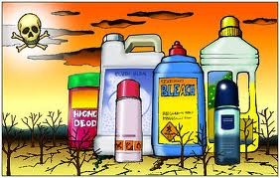
Cont.

Slide 27
Occupational Exposure to Hazardous Chemicals Standard
Includes:
Identifying the types and locations of all chemicals or hazards
Locating and using the MSDS manual
Reading and interpreting chemical labels and hazard signs
Using personal protective equipment (PPE)
Locating cleaning equipment and following correct methods of managing spills and/or disposal of chemicals
Reporting accidents or exposures and documenting any incidents that occur

Slide 28
Question #3
Material Safety Data Sheets (MSDS) include
A. Ingredients to all hazardous products and instructions for use
Special precautions, protections, and health hazard data
Spill, waste, or clean up directions
All of the above

Slide 29
Question #3 answer
Material Safety Data Sheets (MSDS) include
A. Ingredients to all hazardous products and instructions for use
Special precautions, protections, and health hazard data
Spill, waste, or clean up directions
All of the above

Slide 30
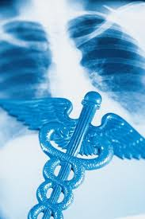
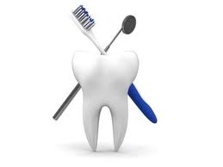
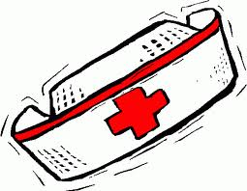
Who Needs To Be Careful
Everyone in health care!
Dentists
Doctors
Aides
Nurses
Dental professionals
Respiratory
OT/PT/ST
Everyone in between (housekeeping, laundry, dietary, etc.)

Slide 31
Blood borne Pathogen Standard
Mandates to protect health care providers from diseases caused by exposure to body fluids
Example:
Blood, blood components
Urine/stool
Semen/vaginal secretions
Cerebrospinal fluids
Saliva/mucus

Slide 32
Trivia
According to the CDC, what leads to most visits to the ER?
Back injuries
Head injuries
Open wounds

Slide 33
Trivia answer
According to the CDC, what leads to most visits to the ER?
Back injuries
Head injuries
Open wounds

Slide 34
For Your Information
One of the top 3 concerns of healthcare providers is:
Contracting a potentially infectious disease (45%)

Slide 35
Question #4
Healthcare workers most often become exposed to hepatitis B, hepatitis C, and HIV through accidental needle sticks?
True
False

Slide 36
Question #4 answer
Healthcare workers most often become exposed to hepatitis B, hepatitis C, and HIV through accidental needle sticks?
True
False

Slide 37
Accidental exposure
Needlesticks
Cuts from contaminated sharps
Scalpels
Broken glass
Dental wire
Contact with mucous membranes
Eyes
Nose
Mouth
Broken skin

Slide 38
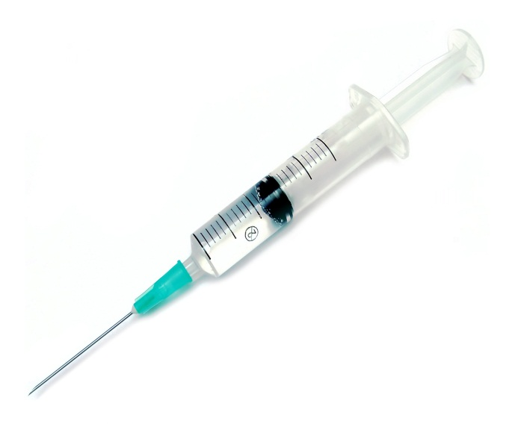
Accidental Exposure
While accidental exposure occurs as evidenced by the video on the previous slide approximately 800,000 needle sticks occur each year.
Prevention is the key
Equipment training
Proper equipment disposal

Slide 39
Re-capping a Needle is a NO!
Never recap a used needle no matter what!
Never stick your hands into a container containing sharps
Never attempt to bend or break off a needle

Slide 40
Safer alternative method to needles
Neeldless systems: a device that does not use needles for the collection or withdrawal of body fluids, or for the administration of medication or fluids
Sharps with engineered sharps injury protection: a non-needle sharp or a needle device used for withdrawing body fluids, accessing a vein or artery, or administering medications or other fluids, with a built-in safety feature or mechanism that effectively reduces the risk of an exposure incident.

Slide 41
Sharps injury log
Employers must maintain a sharps injury log for the recording of injuries from contaminated sharps
The log must be maintained in a way that ensures employee privacy and must contain at a minimum:
Type and brand of device involved in the accident
Location of the incident
Description of the incident

Slide 42
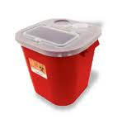
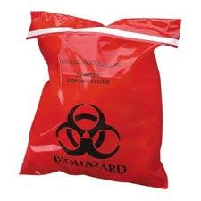

Slide 43
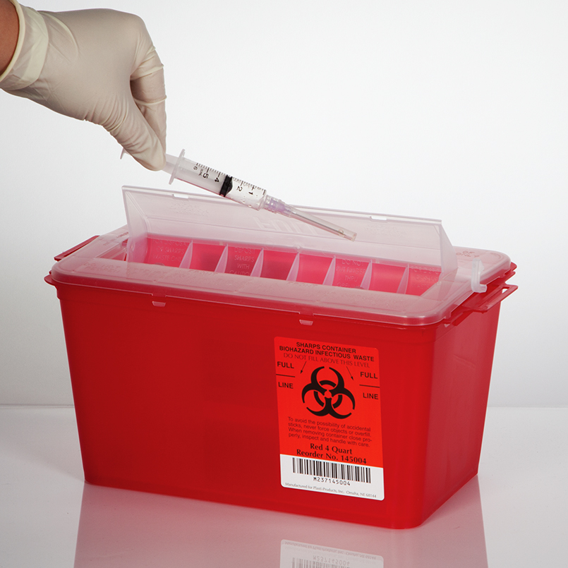
Question #5
Most needle stick injuries occur when disposing of needles, giving medication, drawing blood or handling trash?
True
False

Slide 44
Question #5 answer
Most needle stick injuries occur when disposing of needles, giving medication, drawing blood or handling trash?
True (most sticks are unexpected accidents)
False

Slide 45
housekeeping
Must have written cleaning schedules
All worksites must be decontaminated with the use of disinfectants

Slide 46
Regulated waste
Must be placed in a closeable, leak-proof container built to contain all contents during handling, storing, transporting or shipping, and be appropriately labeled or color-coded

Slide 47
laundry
Must use PPE when handling
Must be bagged or containerized
No sorting or rinsing at location where used
Must be transported in labeled or color-coded containers

Slide 48
Other things to remember!
Employer must provide PPE and PPE must be removed before leaving work area.
Do not eat or drink in a high risk area.
Label specimens and double bag if specimen will be leaving the facility

Slide 49
If an Exposure Occurs
Wash area immediately!
Report the incident
Fill out incident report
Possible testing
Possible treatment
If protocol is followed- employer is responsible for the employee’s care
Some facilities have spill stations

Slide 50
Written policies
Exposure control plan
Provide Hepatitis B Vaccination
PPE (Personal Protective Equipment)
Gowns, gloves, masks, eye protection, etc…
Clean and sanitary work environment
Proper containers for Bio-hazard disposal
Provide training

Slide 51
Blood borne Diseases
Hepatitis B (Can survive outside the body for a week. Vaccination to Prevent)
Hepatitis C (Can survive outside the body for almost 4 days and is the most common chronic blood borne infection in the US- NO CURE)
HIV/AIDS (cannot live outside the body and is the disease with the most misconceptions related to transmission- NO Cure)
Four modes of transmission specific for these three diseases:
Sex
Body Secretions
Sharing Needles
Blood Transfusions

Slide 52
HBV
100 Xs more infectious than HIV
Can take 2-6 months to show symptoms
Hep. C is most prevalent
Signs and Symptoms:
ABD pain (liver)
Joint pain
Fatigue
Yellowing of the eyes

Slide 53
Other Locations of Pathogens
Semen
Vaginal secretions
Cerebrospinal fluid
Synovial fluid
Pleural fluid
Pericardial fluid
Peritoneal fluid
Amniotic fluid
Saliva in dental procedures
Unfixed tissues or organs (living or dead)

Slide 54
More Trivia
The human body: Every square inch has about how many bacteria?
2 million
12 million
22 million
32 million

Slide 55
More Trivia
The human mouth contains more bacteria than there is people in the world!
When a person sneezes 100,000 virus cells spread up to 30 ft. (remember a sneeze is over 100 miles per hour).
Human bowel contains over 100 billion disease causing organisms

Slide 56
Question #6
Fortunately, there are vaccines available to prevent hepatitis B and hepatitis C, and HIV?
True
False

Slide 57
Question #6 answer
Fortunately, there are vaccines available to prevent hepatitis B and hepatitis C, and HIV?
True
False (Vaccination to prevent B)

Slide 58
Understanding the Principles of Infection Control
Microorganisms are small living organisms that are not visible by the naked eye
Classified as either:
Pathogens
Nonpathogens
Bacteria
Viruses
Aerobic
Anaerobic
Everywhere!

Slide 59
Pathogens Related to Infection
Normal flora (colonization)- example: E. Coli in the bowel
Transient flora- example: staph on the skin
Pathogens are everywhere!
Relationship to infection:
Over growth of these pathogens can cause infection, especially in an immunocompromised person

Slide 60
Examples of Pathogens
Bacteria (one bacteria can multiply into 8 million cells in a 24 hour period).
TB (Tuberculosis)
Staph (Staphylococcus)
Strep (Streptococcus)
MRSA (Methicillin-resistant staphylococcus aurous)
VRE (Vancomycin-resistant enterococcus)
Viruses (infect cells, parasitic like nature, feeds off of uninfected cells to thrive)
Hepatitis
HIV
Common Cold/Flu

Slide 61
Nature of Micro-organisms
Disease producing micro-organisms are called pathogens (viruses and bacteria)
Ways to spread
Direct contact- actually touching the organism
Indirect contact- droplets/airborne
Flies, mosquitos, ticks, food (vectors)
Vehicle- inanimate objects

Slide 62
What is an Infection?
Infection is disease resulting from over growth of microbes
An infection can become life-threatening before an older person or someone who is immunocompromised realizes it
Local is one area of the body
Skin tear, pressure ulcer
Systemic is the whole body
Fever, increased pulse, and respiratory rate, pain/tenderness, fatigue, loss of appetite, N&V, redness/swelling, discharge or drainage, etc…

Slide 63
Types of Infection
Endogenous
Disease inside the body related to abnormalities
Exogenous
Disease outside of the body
Nosocomial
Disease contracted through health care
Opportunistic
disease contracted because of impaired immune systems

Slide 64
Signs and Symptoms of Infection
Fever
Confusion
Increased Pulse
Increased Respirations
Drainage and swelling

Slide 65
Internal Body Defense Mechanisms Against Pathogens
Mucous membranes
Cilia
Coughing/sneezing
Hydrochloric acid
Tears
Fever
Inflammation
Immune response- antibodies

Slide 66
Facts About Pathogens
Grow best at body temperature
Destroy human tissue by using it as food
Give off waste products that are called toxins
Toxins poison the body
Can rapidly spread and be deadly in someone who is immunocompromised

Slide 67
Environment for Pathogens
Moisture
Temperature
Oxygen
Lack of sunlight (dark)
Dead and living matter (nourishment)

Slide 68
Question #7
A person has to be sick and showing signs and symptoms of sickness before he/she is able to pass bacteria or viruses to others?
True
False

Slide 69
Question #7 answer
A person has to be sick and showing signs and symptoms of sickness before he/she is able to pass bacteria or viruses to others?
True
False (pathogens are everywhere)

Slide 70
Medical Asepsis
Definition: the practice which helps reduce the number and transfer of pathogens from one place and/or person to another
Reason for practicing medical asepsis:
Micro-organisms are always present in the environment (although some normal). Some micro-organisms can cause illness in certain people (especially those who are immunocompromised)

Slide 71
Aseptic Techniques
Antisepsis- betadine/alcohol
Clean/prepare body with chemicals that eliminate/kill bacteria
Disinfection- (chemical) bleach/Lysol
Process of destroying harmful organisms
Can kill up to 99.9% of bacteria
Sterilization- (heat) autoclaves
Destruction of ALL microorganisms
Important for surgical procedures, wound care, catheterization, etc…

Slide 72
Break the Chain of Infection

Slide 73
Centers for Disease Control
A federal organization that developed standard precautions to minimize or prevent epidemics from spreading
Monitor risk factors, health practices, and rates of disease progression
Purpose is to protect and prevent the spread of illnesses
Hand washing, gloves, use of proper personal protective equipment

Slide 74
Hand Washing
Hand washing- single most important way to minimize pathogens!
When you arrive/leave the facility
Before and after every patient contact
After contact with non-intact skin
Before moving from a contaminated body site
Anytime hands become contaminated
Before and after applying/removing gloves
Before and after specimen handling
After picking item up off the floor
After you cough, sneeze, or use a tissue
Before and after eating
Before and after using the bathroom
Before and after contact with your face/hair

Slide 75
Why Wash Your Hands?
Everything you touch has germs on it
You use your hands constantly
You can carry germs to others
Your constant adherence to good hand washing prevents transfer of germs!

Slide 76
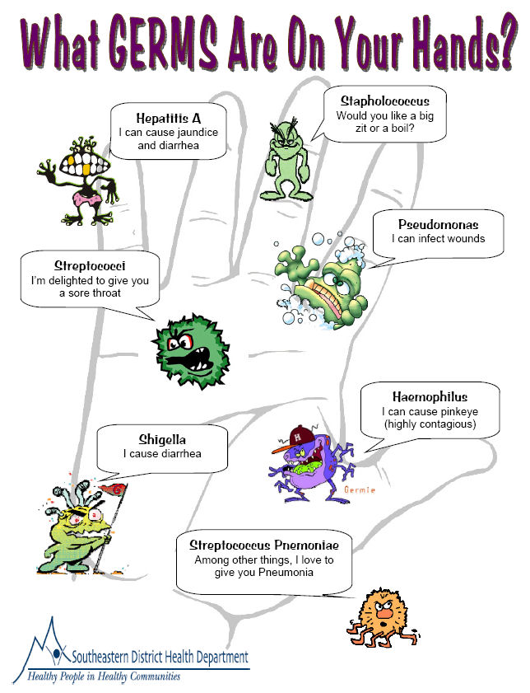

Slide 77
Hand washing
http://youtu.be/pNOrrKjGgkU

Slide 78
Types of Hand Washing
Normal hand washing- what you do before and after providing care
Surgical scrub- 2 minute or more scrub performed before surgical procedure
Antiseptic wash- scrubbing the skin with antiseptic (betadine or alcohol) before surgical procedure

Slide 79
Hand Washing Technique
Use lots of soap to produce lather
Vigorous scrubbing for 15 seconds or more to remove organisms
Clean all surfaces including nails and wrists
Point fingertips downward toward sink
Never touch the sink
Dry hands thoroughly and discard paper towel
Use dry paper towel to turn of faucet

Slide 81
Hand Sanitizer
Is appropriate when:
A sink is not available
And in between non-invasive care
Should NOT be used when caring for C-diff patients because alcohol does not effectively kill the spores associated with the pathogen (examples: MRSA and C-diff)
Use according to manufacturer’s direction
Apply to palm of one hand, rub hands together completely covering all surfaces of the hands with the sanitizer until hands and fingers are dry.

Slide 82
Gloving
The CDC and OSHA standards both state
Gloves shall be worn when it can be reasonably anticipated that the employee may have hand contact with blood, other potentially infectious materials, mucous membranes, and non-intact skin.
Must wash hands before and after gloving

Slide 83
Masks, Eye Protection, and Face Shields
Masks in combination with eye protection devises shall be worn whenever splashes, sprays, splatter, or droplets of blood or other potentially infectious materials may be generated and eye, nose, or mouth contamination can be reasonably anticipated

Slide 84
Gowns, Aprons, and Other Protective Body Clothing
Appropriate protective clothing such as gowns, aprons, lab coats, or similar outer garments shall be worn in occupational exposure situations
Surgeries
Dental cares
ICU’s
Labor and Delivery
Respiratory cares
Emergency situations

Slide 85
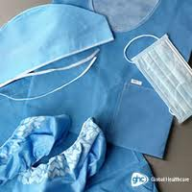

Slide 86
Also includes
Isolation/Reverse Isolation
Purpose is to protect patient/s and self from contracting or spreading disease
Airborne precautions
Droplet precautions
Contact precautions
Must wear proper PPE (gowns, gloves, masks, goggles, etc…)
Must wash hands- no hand sanitizer!

Slide 87
Question #8
The number one way to reduce the transmission of pathogens is to?
A. Wash your hands frequently
B. Wear gloves for all patient contact
C. Use hand sanitizer at all times
D. All of the above

Slide 88
Question #8 answer
The number one way to reduce the transmission of pathogens is to?
A. Wash your hands frequently
B. Wear gloves for all patient contact
C. Use hand sanitizer at all times
D. All of the above

Slide 89
Disease Examples
Tuberculosis (TB) is caused by a bacteria that attacks the lungs and is spread through the air
Flu- viral
Common Cold (virus)
Hepatitis A, B, C (virus)
MRSA (bacteria)

Slide 90
Reinfection & Cross Infection
Practicing medical asepsis can prevent
Reinfection- becoming infected a second time with the same disease
Cross infection- infected by microorganisms from another patient or member of staff
Always wash hands between patients and procedures
Always disinfect equipment after each use
Always wear proper PPE

Slide 91
Other Ways to Prevent the Spread of Pathogens
Clean and disinfect equipment and patient rooms
Dispose of contaminated articles correctly
Be aware of surroundings and work to prevent environmental contaminations

Slide 92
Using Body Mechanics
Refers to the way in which the body moves and maintains balance while making the most efficient use of all its parts.
Helps prevent undue strain and helps with muscle strength
The number one musculoskeletal injury health care professionals experience is back injuries

Slide 93
Trivia
One of the top 3 concerns of healthcare providers are concerned about potential back injuries (59%)

Slide 94
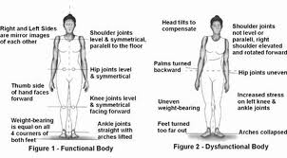

Slide 95
Ergonomics
Is an applied science used to promote the safety and well-being of a person by adapting the environment and using techniques to prevent injuries.
Contouring the job to fit the person and keep them safe

Slide 96
Four Reasons for Using Good Body Mechanics
Muscles work best when used correctly
Correct use of muscles makes lifting, pulling, and pushing easier
Correct application of body mechanics prevents unnecessary fatigue and strain, and saves energy
Correct application of body mechanics prevents injury to self and others

Slide 97
Eight Basic Rules
Maintain a broad base of support
Bend from the hips and knees and get close to the object while keeping your back straight
Use the strongest muscles to do the job
Use the weight of your body to help
Carry heavy objects close to the body
Avoid twisting
Avoid bending for long periods
If patient or object too heavy- GET HELP!

Slide 98
Equipment Safety
Do not operate or use any equipment until you have been instructed on how to use it
Read and follow the operating instructions for all major pieces of equipment
Do not operate any equipment if your instructor of immediate supervisor is not in the room
Report any damaged or malfunctioning equipment immediately!
Do not use frayed or damaged electrical cords
Store equipment properly
Read MSDS before using hazardous chemicals

Slide 99
Patient/Resident Safety
Do not perform procedures on patients unless you have been instructed to do so
Provide privacy for patients
Always identify yourself
Always explain the procedure to the patient
Observe the patient closely
Check all safety points

Slide 100
Personal Safety
Remember it is your responsibility to protect yourself and others from injury
Use correct body mechanics while performing any procedure
Wear proper uniform
Walk-Do not run
Promptly report accidents/injuries
If you see any unsafe situation or violation of safety practices, report it
Keep all areas clean and neat
Wash hands and keep hands away from face
Work with your partner

Slide 101
Health Care Worker Safety
https://youtu.be/qbuSZ9rOKNk

Slide 102
Question #9
The number one musculoskeletal injury health care professionals experience?
A. shoulder injuries
B. Knee injuries
C. Back injuries
D. Ankle injuries

Slide 103
Question #9 answer
The number one musculoskeletal injury health care professionals experience?
A. shoulder injuries
B. Knee injuries
C. Back injuries
D. Ankle injuries

Slide 104
Fire Safety
Three things to start a fire
Oxygen
Fuel
Heat

Slide 105
Fire Extinguishers
Class A
Class B
Class C
Class D
ABC extinguishers
Most facilities use the combo type
Must receive training to operate

Slide 106
Safety Plan
Must be educated about fire safety plan (every facility is different)
Must have fire drills practicing fire emergency plan
RACE
Rescue
Alarm
Contain
Extinguish/evacuate

Slide 107
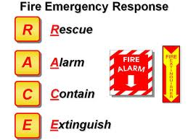

Slide 108
UMC Safety Dance Music Video
http://youtu.be/kg-2kEzWIOI

Slide 109
Question #10
The acronym RACE stands for what?
A. Run, alarm, contain, evaluate
B. React, Alarm, Constraint, Evaluation
C. Report, alarm, contain, emergency
D. Rescue, Alert, Contain, Extinguish/Evacuate

Slide 110
Question #10 answer
The acronym RACE stands for what?
A. Run, alarm, contain, evaluate
B. React, Alarm, Constraint, Evaluation
C. Report, alarm, contain, emergency
D. Rescue, Alert, Contain, Extinguish/Evacuate

Slide 111
References
Youtube.com
http://www.osha.gov/SLTC/healthcarefacilities/index.html
http://www.osha.gov/SLTC/healthcarefacilities/standards.html
http://www.cdc.gov/niosh/topics/bbp/genres.html
http://www.cdc.gov/oralhealth/infectioncontrol/faq/

Slide 112
References
http://www.osha.gov/Publications/osha3186.html
http://www.osha.gov/Publications/OSHA-factsheet-HIPPA-whistle.pdf
http://www.onesourcedoc.com/glog/bid/95168/10-Examples-of-HIPAA-Violations

